Slide 1
Data Communication & Computer Networks
Course Instructor:
Mr. Fakhar Ul Islam

Slide 2
Road Map
  1Network Classification
    Based on area
    Based on component role
    Based on connectivity
    Based on transmission medium
  2 Internet of Things
      LPWAN

Slide 3






NETWORK CLASSIFICATION OF AREA BY THEIR GEOGRAPHY

Slide 4
LOCAL AREA NETWORK(LAN)
LAN is a network which is designed to operate over a small physical area such as an office, factory or a group of buildings.
LAN’s are easy to design and troubleshoot
Exchange of information and sharing of resources becomes easy because of LAN.
In LAN all machines are connected to a single cable.
Different types of topologies such as star, tree, bus, ring, etc Can be used
It is usually a privately owned network.

Slide 5
WIDE AREA NETWORK(WAN)
When network spans over a large distance or when the computers to be connected to each other are at widely separated locations a local area network cannot be used. A wide area network(WAN) is installed.
The communication between different users of WAN is established using leased telephone lines, satellite links and similar channels.
It is cheaper and more efficient to use the phone network for the link.
Most WAN networks are used to transfer large blocks of data between its users.

Slide 6
PERSONAL AREA NETWORK(PAN)
A personal area network is a computer network organized around an individual person.
It generally consists of a mobile computer, a cell phone or personal digital assistant. PAN enables the communication among these devices.
The PANs can be constructed using wireless or cables.

Slide 7
CAMPUS AREA NETWORK(CAN)
The campus area network is made up of an interconnection of LAN with limited geographical area.
Network equipment's such as switches, routers and the transmission media i.e. optical fibre etc are almost entirely owned by the campus owner.

Slide 8
METROPOLITAN AREA NETWORK(MAN)
It is in between LAN & WAN technology that covers the entire city.
It uses similar technology as LAN.
It can be a single network such as cable TV network

Slide 9
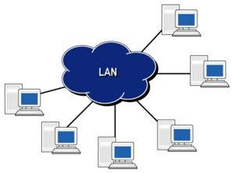
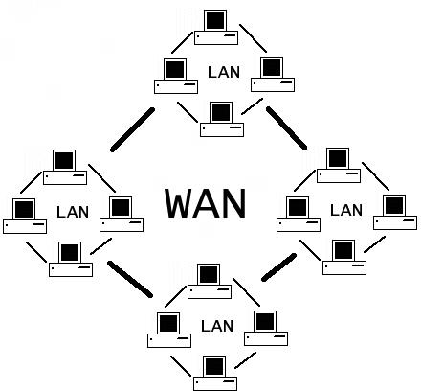
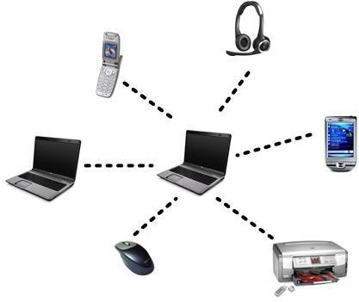
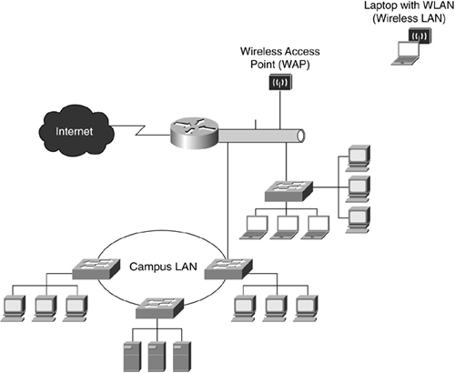
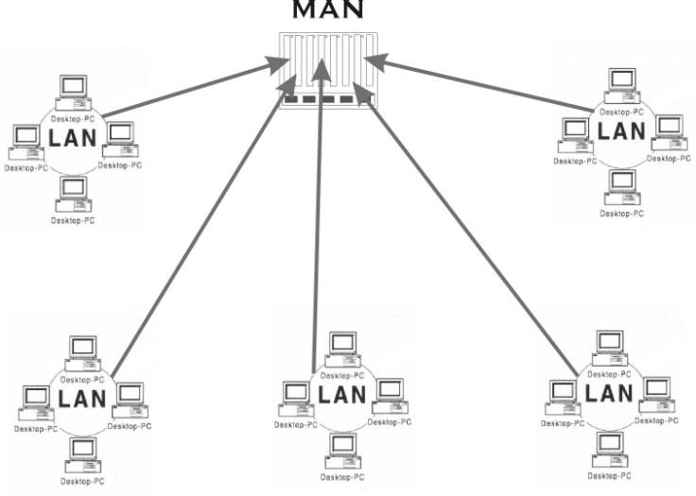
WAN
LAN
PAN
CAN
MAN

Slide 10
DISTINGUISH BETWEEN LAN,WAN,MAN
PARAMETERS | LAN | WAN | MAN
Ownership of network | Private | Private or public | Private or public
Geographical area covered | Small | Very large | Moderate
Design and maintenance | Easy | Not easy | Not easy
Communication medium | Coaxial cable | PSTN or satellite links | Coaxial cables, PSTN, optical fibre, cables, wireless
Bandwidth | Low | High | moderate
Data rates(speed) | High | Low | moderate

Slide 11





NETWORK CLASSIFICATION BY THEIR COMPONENT ROLE
LOCAL AREA NETWORK
PEER TO PEER NETWORK
CLIENT SERVER NETWORK

Slide 12
PEER TO PEER NETWORK
In peer to peer network each computer is responsible for making its own resources available to other computers on the network.
Each computer is responsible for setting up and maintaining
its own security for these resources.
Also each computer is responsible for accessing the required network resources from peer to peer relationships.
Peer to peer network is useful for a small network containing
less than 10 computers on a single LAN .
Peer to peer networks do not have a central control system.
There are no servers in peer networks.
Peer networks are amplified into home group.

Slide 13
ADVANTAGES & DISADVANTAGES OF PEER TO PEER NETWORK
Advantages:
Use less expensive computer hardware
Easy to administer
Easy setup & low cost
Disadvantages:
Not very secure
No central point of storage or file archiving
Additional load on computer because of resource sharing

Slide 14
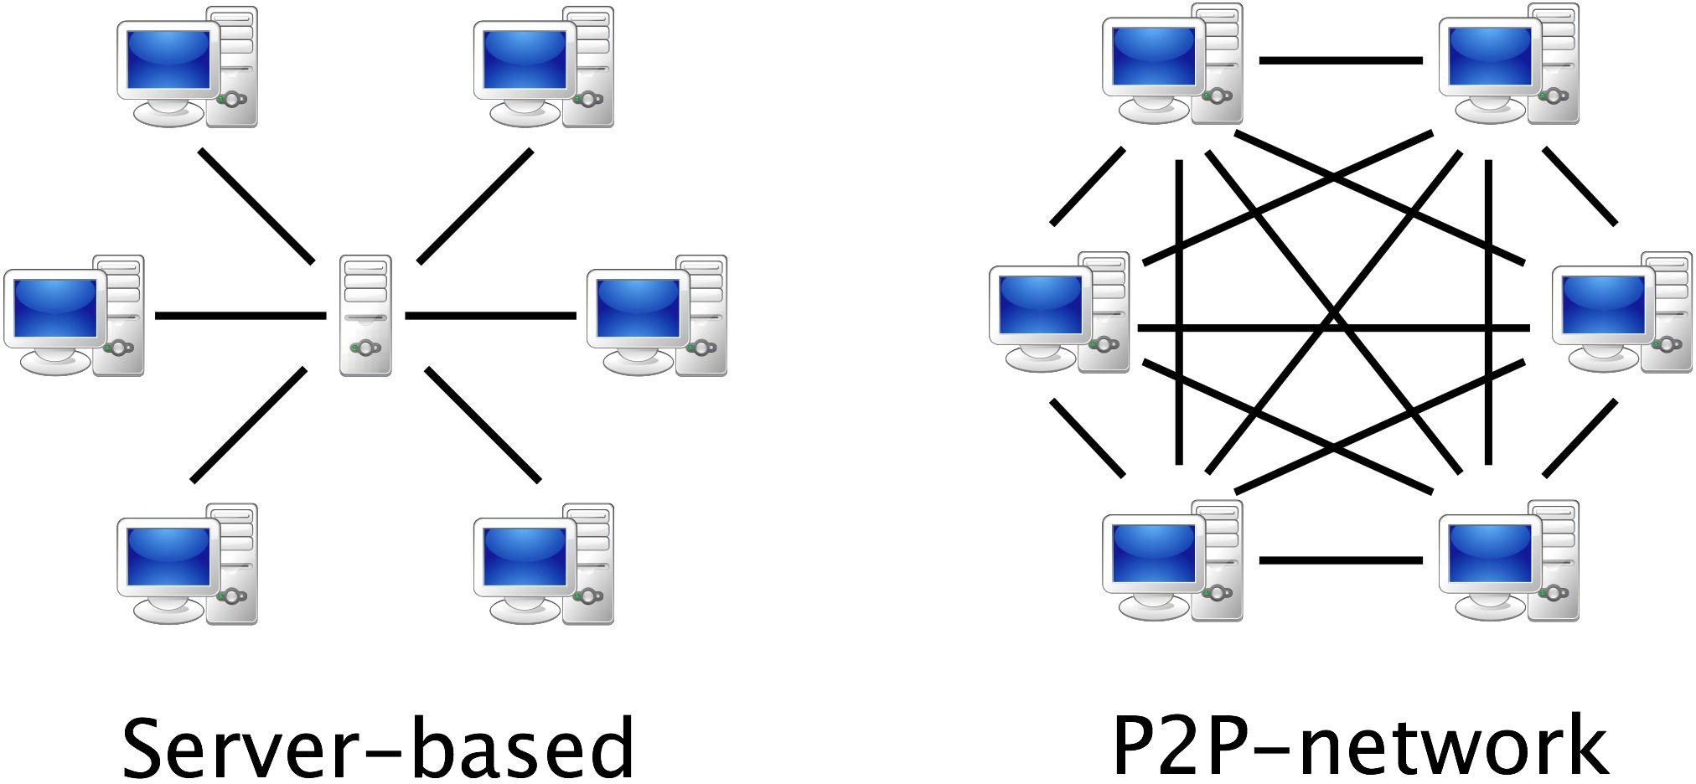

Slide 15
CLIENT/SERVER NETWORK
In client-server network relationships, certain computers act as server and other act as clients. A server is simply a computer, that available the network resources and provides service to other computers when they request it. A client is the computer running a program that requests the service from a server.
Local area network(LAN) is based on client server network relationship.
A client-server network is one n which all available network resources such as files, directories, applications and shared devices, are centrally managed and hosted and then are accessed by client.
Client serve network are defined by the presence of servers on a network that provide security and administration of the network.

Slide 16
ADVANTAGES AND DISADVANTAGES OF CLIENT-SERVER NETWORK
Disadvantages:
requires professional administration
More hardware- intensive
More software intensive
Expensive dedicated software
Advantages:
Very secure
Better performance
Centralized backup
very reliable

Slide 17





TYPES OF SERVERS

Slide 18
TYPES OF SERVERS
File server: These servers provide the services for storing, retrieving and moving the data. A user can read, write, exchange and manage the files with the help of file servers.
Printer server: The printer server is used for controlling and managing printing on the network. It also offers the fax service to the network users.
Application server: The expensive software and additional computing power can be shared by the computers in a network with he help of application servers.
Message server: It is used to co-ordinate the interaction between users, documents and applications. The data can be used in the for of audio, video, binary, text or graphics.
Database server: It is a type of application server. It allows
the uses to access the centralised strong database.

Slide 19
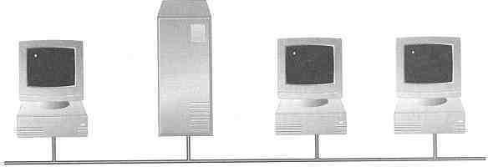
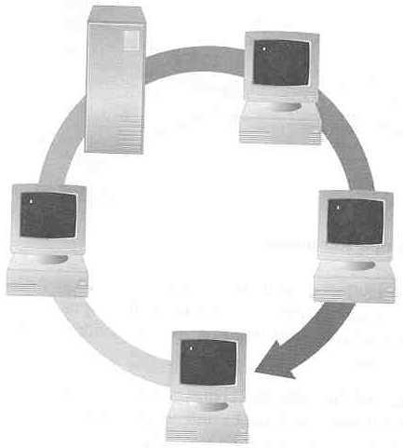
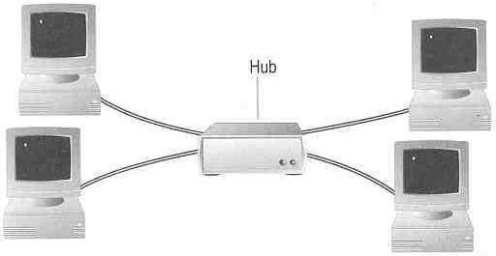
Network Classification based on TOPOLOY(Connectivity)
How so many computers are connected together? Bus Topology Ring Topology
Star Topology
Hub

Slide 20
TOPOLOY
Bus Topology
  Simple and low-cost
  A single cable called a trunk (backbone, segment)
  Only one computer can send messages at a time
  Computer only listen for, not regenerate data
Star Topology
  Each computer has a cable connected to a single point
  More cabling, hence higher cost
  All signals transmission through the hub; if down, entire network down
  Depending on the intelligence of hub, two or more computers may send message at the same time

Slide 21
TOPOLOY
Ring Topology
  Every computer serves as a repeater to boost signals
  Typical way to send data:
    Token passing
      only the computer who gets the token can send data
  Disadvantages
    Difficult to add computers
    More expensive
    If one computer fails, whole network fails

Slide 22
Network Classification based on TRANMISSION MEDIA
Two main categories:
  Guided ― wires, cables
  Unguided ― wireless transmission, e.g. radio, microwave, infrared, sound, sonar
We will concentrate on guided media here:
  Twisted-Pair cables:
    Unshielded Twisted-Pair (UTP) cables
    Shielded Twisted-Pair (STP) cables
  Coaxial cables
  Fiber-optic cables

Slide 23
Some factors need to be considered for designing the transmission media:
Bandwidth: All the factors are remaining constant, the greater the bandwidth of a medium, the higher the data transmission rate of a signal.
Transmission impairment: When the received signal is not identical to the transmitted one due to the transmission impairment. The quality of the signals will get destroyed due to transmission impairment.
Interference: An interference is defined as the process of disrupting a signal when it travels over a communication medium on the addition of some unwanted signal.

Slide 24
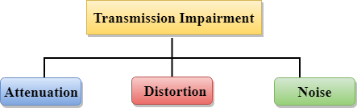
Causes Of Transmission Impairment:
Attenuation: Attenuation means the loss of energy, i.e., the strength of the signal decreases with increasing the distance which causes the loss of energy.
Distortion: Distortion occurs when there is a change in the shape of the signal. This type of distortion is examined from different signals having different frequencies. Each frequency component has its own propagation speed, so they reach at a different time which leads to the delay distortion.
Noise: When data is travelled over a transmission medium, some unwanted signal is added to it which creates the noise.

Slide 25
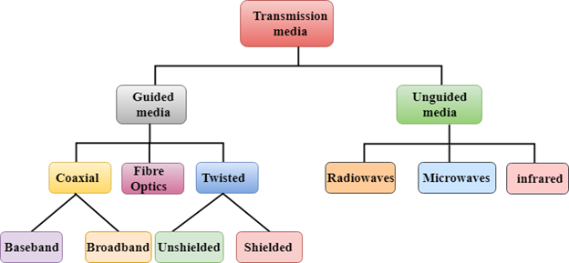
Classification Of Transmission Media:
Notes:
Baseband transmits single signal at time very high speed, broadband cable can transmit many simultaneous signals using different frequencies.

Slide 26
Internet of Things (IoT)
The Internet of Things (IoT) is the network of
physical and with
objects—devices, vehicles,
buildings embedded sensors
other electronics,
items software,
and network
connectivity that enables these
objects to collect and exchange data.
Allows remotely
objects to be sensed across
and controlled
network
existing
infrastructure

Slide 27
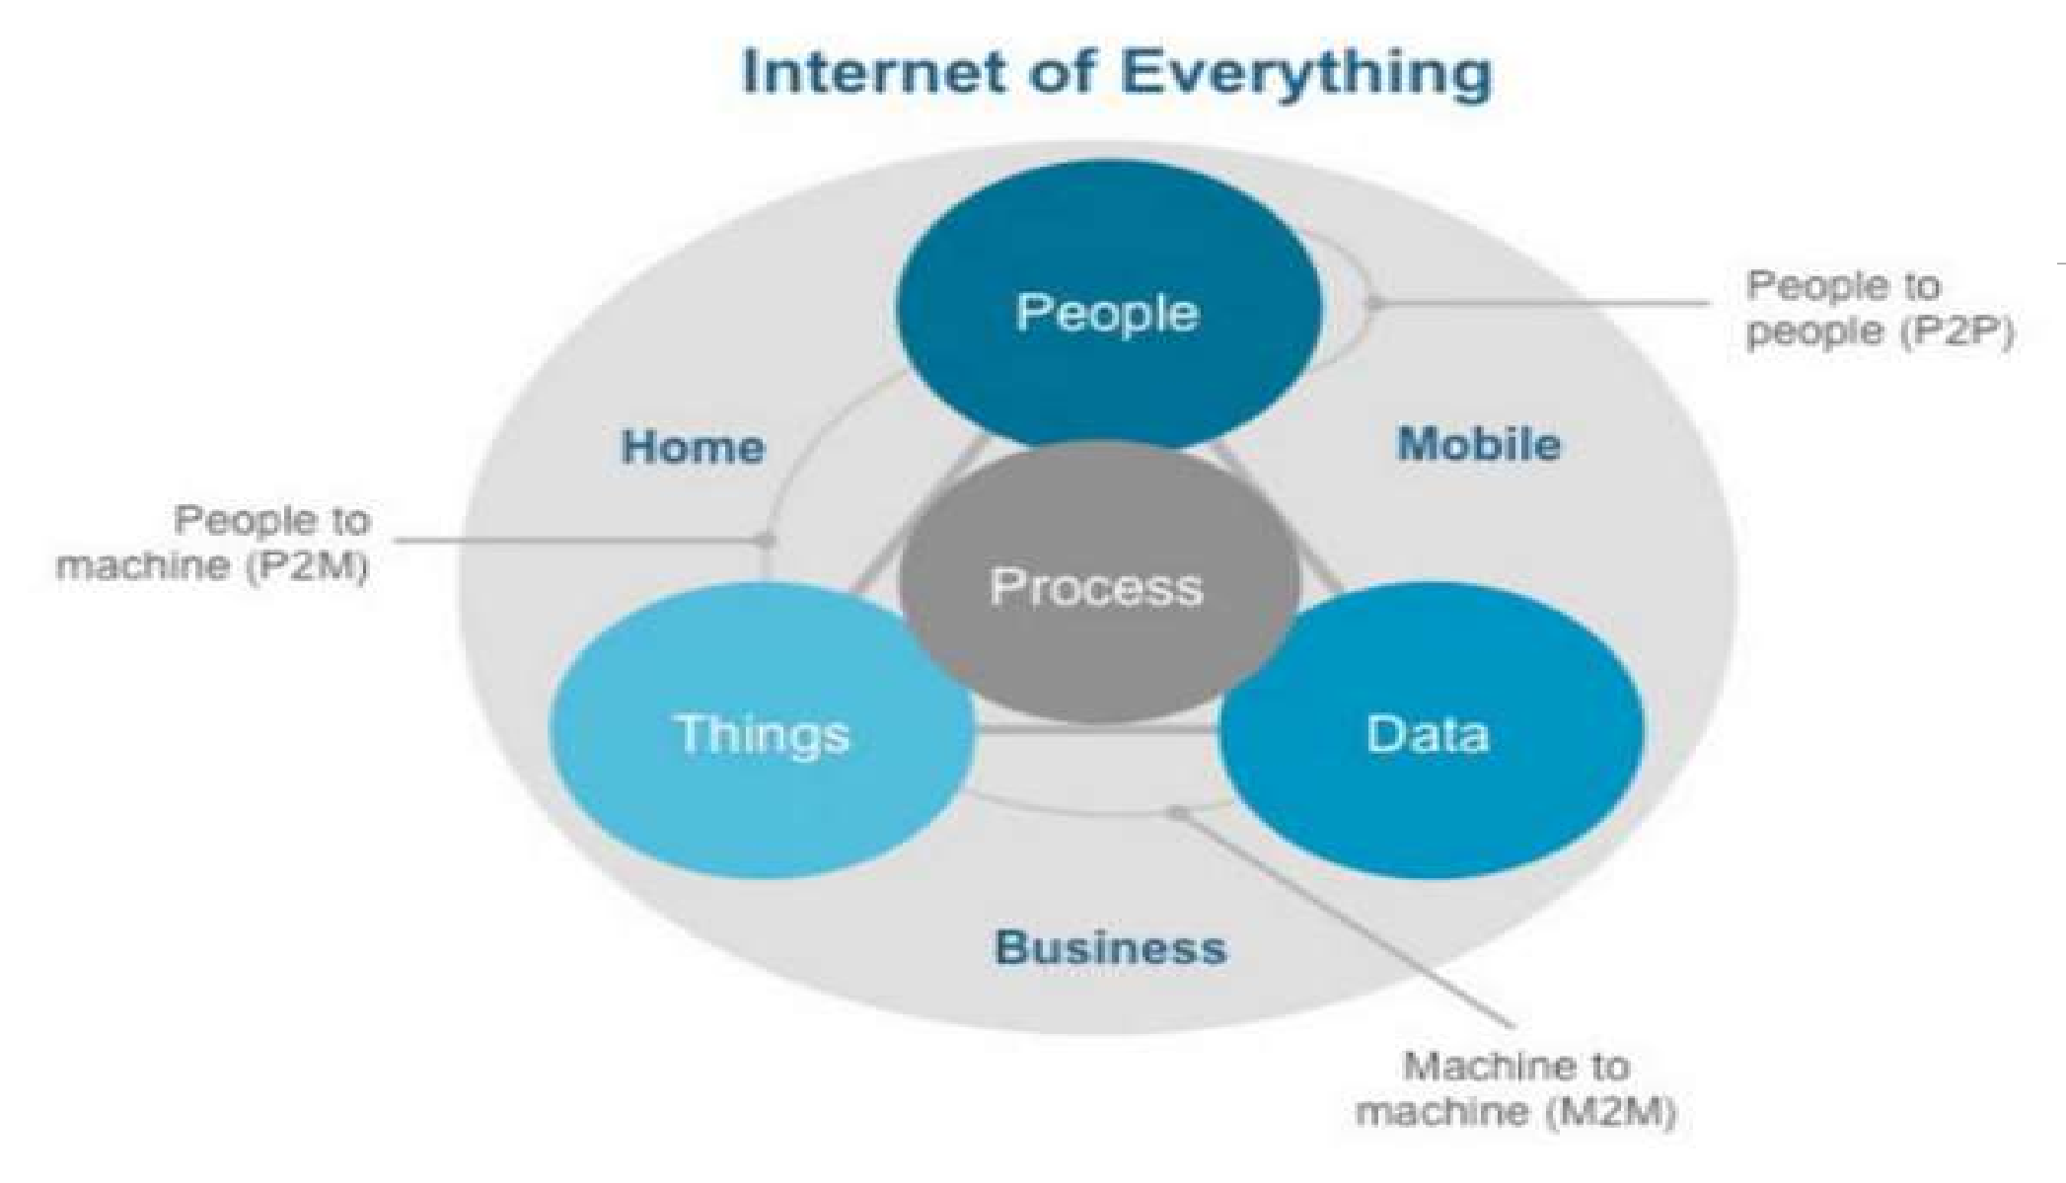

Slide 28


























LPWAN – Low Power Wide Area Network
Different wireless technologies cover different applications with regard to range and bandwidth. Long-range applications with low bandwidth requirements that are typical for IoT and M2M scenarios are not well supported by these existing technologies.
LPWAN technologies are targeted at these emerging applications and markets.
802.11ac
802.11ad
802.11n
High BW
5G
4G
802.11a
802.11b
802.11g
3G
2G
Medium BW
VSAT
BlueTooth
ZigBee /
BLE
802.15.4
WBAN 802.15.6
LPWAN
Low BW
RFID / NFC
WPAN
802.15.3
Key:
BW: Bandwitch
IoT: Internet of Things M2M: Machine to Machine
Short Range
Medium Range
Long Range

Slide 29
Q/A

